Slide 1
Histogram of Oriented Gradients
John Charlesworth
Michael Hodgson

Slide 2
Contents
Introduction
The Process
Results
Conclusions
References

Slide 3
Introduction
Histogram of oriented gradients is a feature descriptor
Used in conjunction with a training data set and a classifier

Slide 4
The HOG Process
Compute Gradients
Compute Orientation
Histograms
Normalise
Collect over window
Linear SVM
Compute Gradients
Compute Orientation of Gradients
Compute a Histogram of these for a “Cell”
Normalise the “Cell” over a “Block”
Collect for Entire Image

Slide 5

Blocks and Cells
Compute Gradients
Compute Orientation
Histograms
Normalise
Collect over window
Linear SVM
Block
Cell

Slide 6
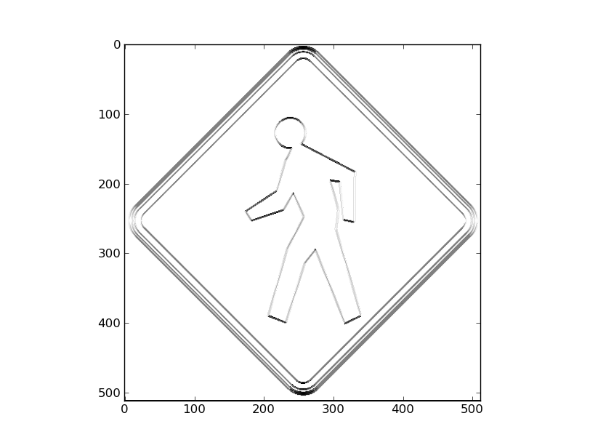
The HOG Process
Compute Gradients
Compute Orientation
Histograms
Normalise
Collect over window
Linear SVM
Gradients Calculated by convolution with simple kernels
0 | 0 | 0
-1 | 0 | 1
0 | 0 | 0
0 | -1 | 0
0 | 0 | 0
0 | 1 | 0

Slide 7
The HOG Process
Compute Gradients
Compute Orientation
Histograms
Normalise
Collect over window
Linear SVM
The orientation of the gradient at each pixel is calculated
Orientation (in Radians) = arctan (horizontal gradient / vertical gradient)

Slide 8
The HOG Process
Compute Gradients
Compute Orientation
Histograms
Normalise
Collect over window
Linear SVM
A histogram is then computed over a cell with 9 bins between 0 and π (unsigned orientation) or – π and π (signed orientation)
Number of bins and signed or unsigned orientations chosen from paper

Slide 9
The HOG Process
Compute Gradients
Compute Orientation
Histograms
Normalise
Collect over window
Linear SVM
Cell

Slide 10
The HOG Process
Compute Gradients
Compute Orientation
Histograms
Normalise
Collect over window
Linear SVM
Cell

Slide 11
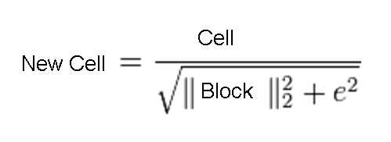
The HOG Process
Compute Gradients
Compute Orientation
Histograms
Normalise
Collect over window
Linear SVM
The histogram of a cell is normalised with respect to a block
The L2-norm of the block is taken
e is a small constant

Slide 12
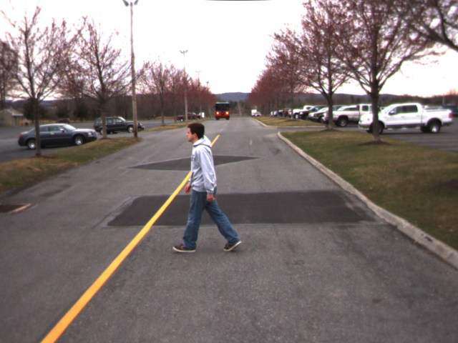
The HOG Process
Compute Gradients
Compute Orientation
Histograms
Normalise
Collect over window
Linear SVM

Slide 13
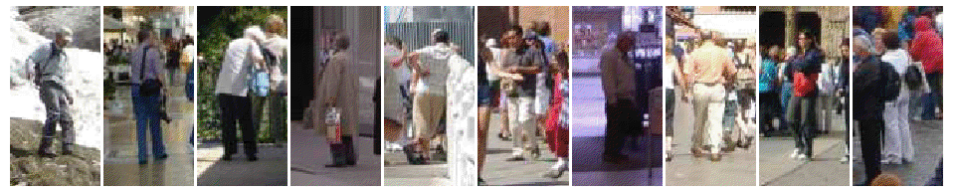
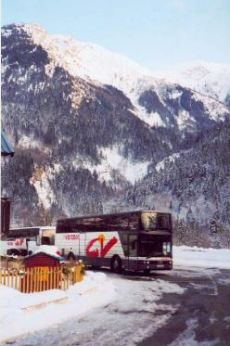
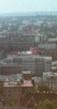
The HOG Process
Compute Gradients
Compute Orientation
Histograms
Normalise
Collect over window
Linear SVM
Trained with large selection of pictures of people
And of not people

Slide 14
The HOG Process
Compute Gradients
Compute Orientation
Histograms
Normalise
Collect over window
Linear SVM
Retrained on false positives
SVM predicts whether a HOG window contains a person
Scale sensitive

Slide 15
The HOG Process
Compute Gradients
Compute Orientation
Histograms
Normalise
Collect over window
Linear SVM
For locating objects a sliding window is used

Slide 16
The HOG Process
Compute Gradients
Compute Orientation
Histograms
Normalise
Collect over window
Linear SVM
Experimented with scale invariance

Slide 17
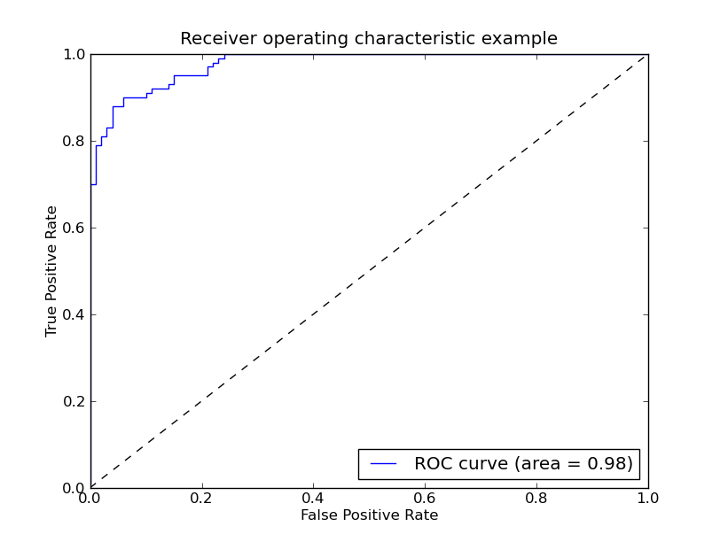
Results
ROC curve
Notes:
Location invariance
Scale invariance?
False positives
Computation time
Use awesome Godzilla picture for demo

Slide 18
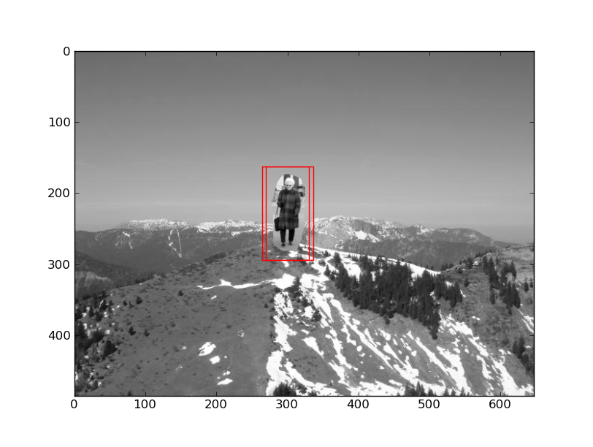
Results

Slide 19
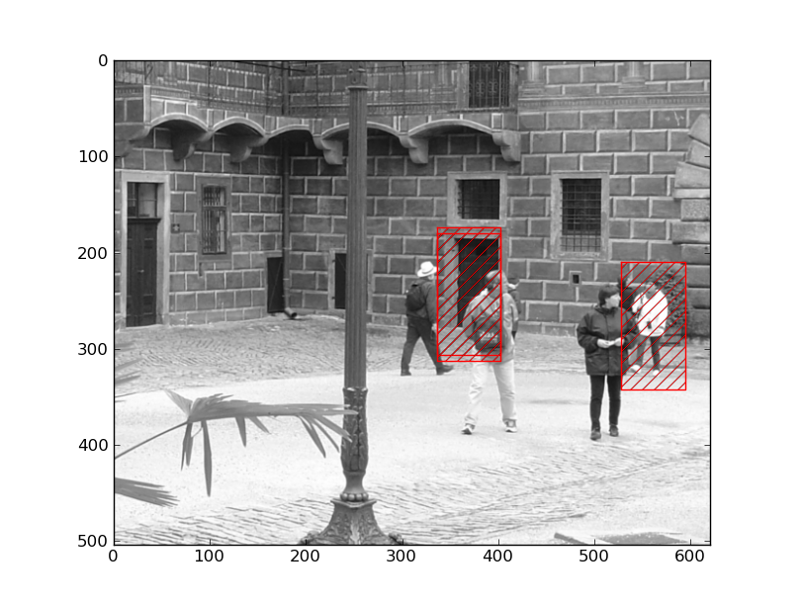
Results
Effect of scale sensitivity and a false positive

Slide 20
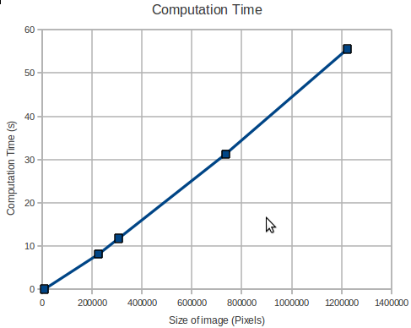
Results – Computation Time
Notes:
For 1 scale

Slide 21
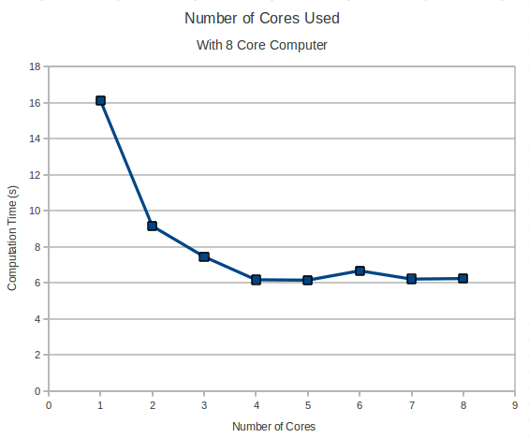
Results – Multi-threading

Slide 22

Demo

Slide 23
Extensions
Images taken from [2] showing use of scale space to add robustness to detection
Results from the paper show better detection through use of scale space and mode filter

Slide 24
Conclusions
High performance on test set
Real world gives lower performance
Scale sensitive
Requires careful training
Multi-threading improves computation time

Slide 25
References
Histograms of Oriented Gradients for Human Detection, Naveet Dalal and Bill Triggs, Available: http://ieeexplore.ieee.org/stamp/stamp.jsp?tp=&arnumber=1467360
Object detection using Histograms of Oriented Gradients, Naveet Dalal and Bill Triggs, Available: http://pascallin.ecs.soton.ac.uk/challenges/VOC/voc2006/slides/dalal.pdf

